Slide 1
Recunoasterea scrisului de mana
Robert Mihai Pandele
Voicu-Florin MANOLACHE

Slide 2
Arhitectura
Keras
TensorFlow
OCR

Slide 3
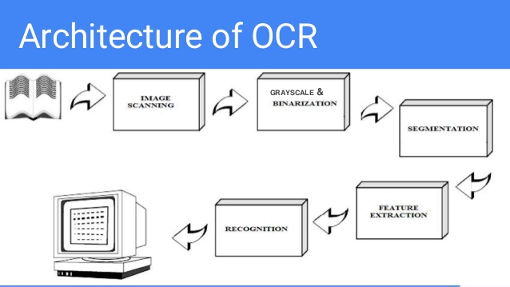
Arhitectura

Slide 4
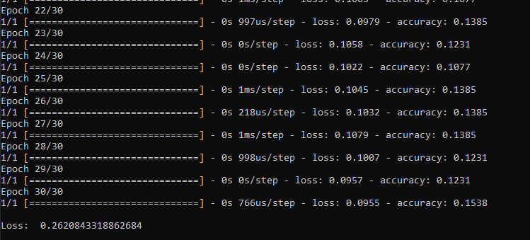
Alte abordari
LSTM

Slide 5

Masuratori LSTM
LSTM+ Curbe Bezier

Slide 6
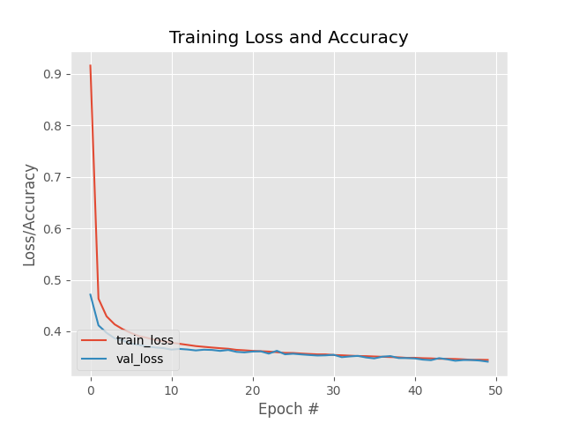
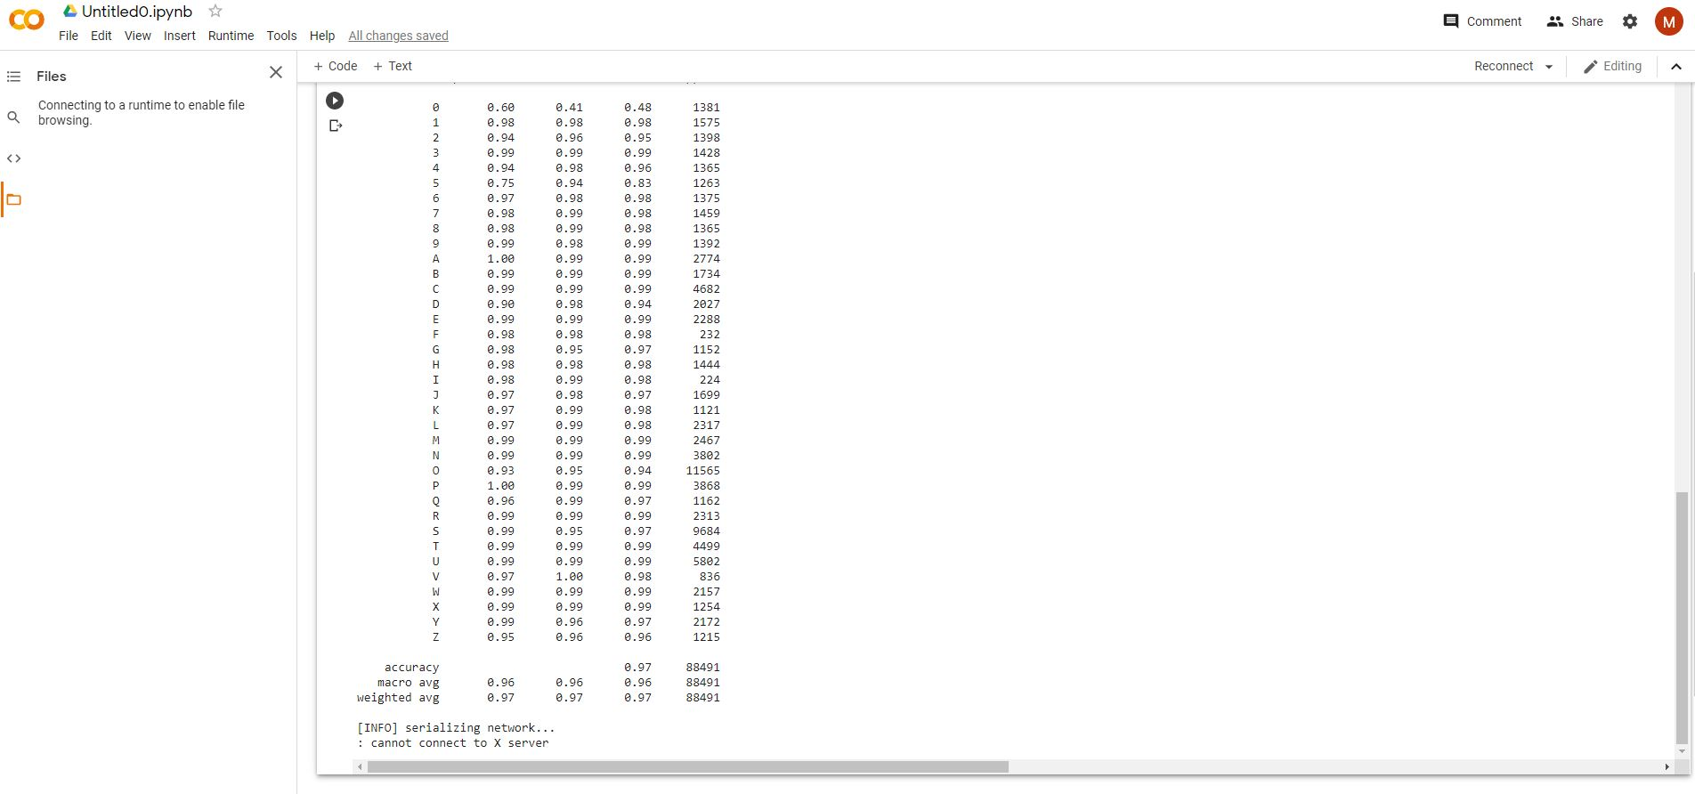
Masuratori MNIST

Slide 7
Masuratori MNIST
Feature | pixel | PCA | 4-grad | 8-grad
k-NN | 3.66 | 3.01 | 1.26 | 0.97
MLP | 1.91 | 1.84 | 0.84 | 0.60
RBF | 2.53 | 2.21 | 0.92 | 0.69
PC | 1.64 | N/A | 0.83 | 0.58
SVC-poly | 1.69 | 1.43 | 0.76 | 0.55
SVC-rbf | 1.41 | 1.24 | 0.67 | 0.42

Slide 8
Concluzie si idei viitoare
Recunoasterea literelor si a numerlor pentru scrisul discret
Makeshift autocorrect

Slide 9
Bibliografie
(PDF) Fast Multi-language LSTM-based Online Handwriting Recognition (researchgate.net)
(PDF) Performance evaluation of pattern classifiers for handwritten character recognition (researchgate.net)
(PDF) Classification and Learning for Character Recognition: Comparison of Methods and Remaining Problems (researchgate.net)
LSTM-based Handwriting Recognition by Google | by Edward Ma | Towards Data Science
Handwriting Recognition using LSTM Networks (neliti.com)
(PDF) Offline Handwriting Recognition Using LSTM Recurrent Neural Networks (researchgate.net)

Slide 10
Sfarsit
Multumesc de atentie!

